Slide 1
A Brief History of AI
COMP 41400: Multi-Agent Systems
Lecturer: Rem Collier
Email: rem.collier@ucd.ie

Slide 2
Artificial Intelligence
The creation of intelligent “thinking machines”
The development of machines that replicate human intelligence.
Exhibit features such as awareness, learning, creativity, anticipation, …
Increasingly intelligence is linked to embodiment…
Often concerned with/inspired by:
Philosophy: Behaviourism vs Duality?
Nature/Neuroscience: How do we/other things work?
Ethics: Who is responsible for its actions?
How can we judge if something is intelligent?
Notes:
“do machines dream of electric sheep” -> Blade Runner

Slide 3
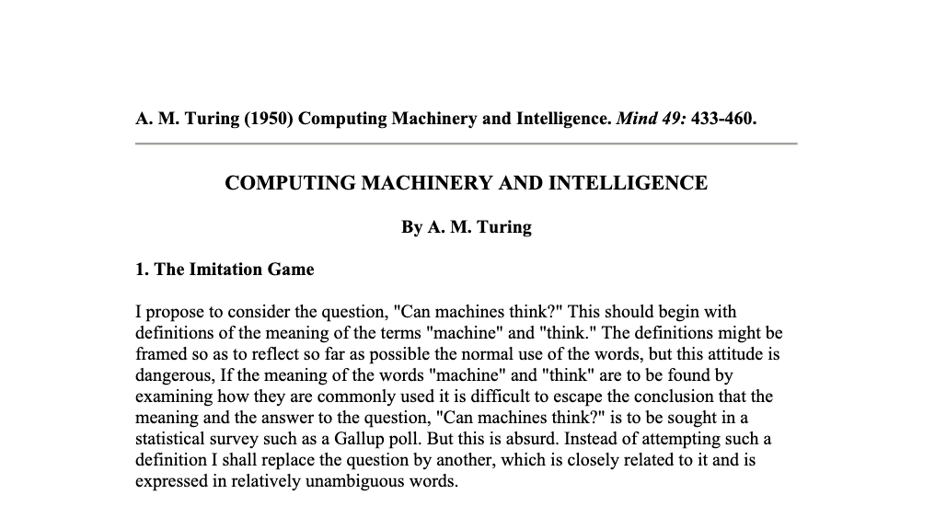
The Turing Test (1950) COMPUTING MACHINERY & INTELLIGENCE https://www.csee.umbc.edu/courses/471/papers/turing.pdf

Slide 4
The Turing Test (1950) COMPUTING MACHINERY & INTELLIGENCE https://www.csee.umbc.edu/courses/471/papers/turing.pdf
The test is organised as a game with three participants: an interrogator, a human and a machine (conversation lasts for at least 5 minutes).

Slide 5
The Turing Test (1950) COMPUTING MACHINERY & INTELLIGENCE https://www.csee.umbc.edu/courses/471/papers/turing.pdf
The test is organised as a game with three participants: an interrogator, a human and a machine (conversation lasts for at least 5 minutes).
The interrogator is physically removed from the other two participants.
He can communicate with each of them by way of a teletype (a chat system), he does not however, know which participant is machine and which is human.

Slide 6
The Turing Test (1950) COMPUTING MACHINERY & INTELLIGENCE https://www.csee.umbc.edu/courses/471/papers/turing.pdf
The test is organised as a game with three participants: an interrogator, a human and a machine (conversation lasts for at least 5 minutes).
The interrogator is physically removed from the other two participants.
He can communicate with each of them by way of a teletype (a chat system), he does not however, know which participant is machine and which is human.
The task of the interrogator is to establish which one is the machine and which is the human.

Slide 7
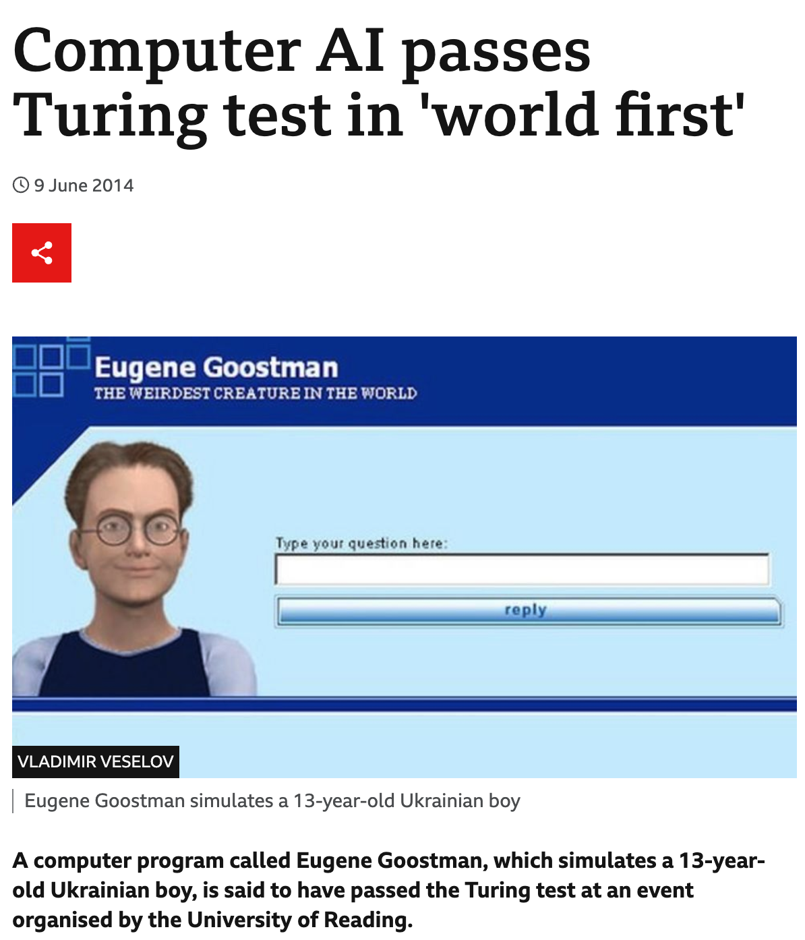
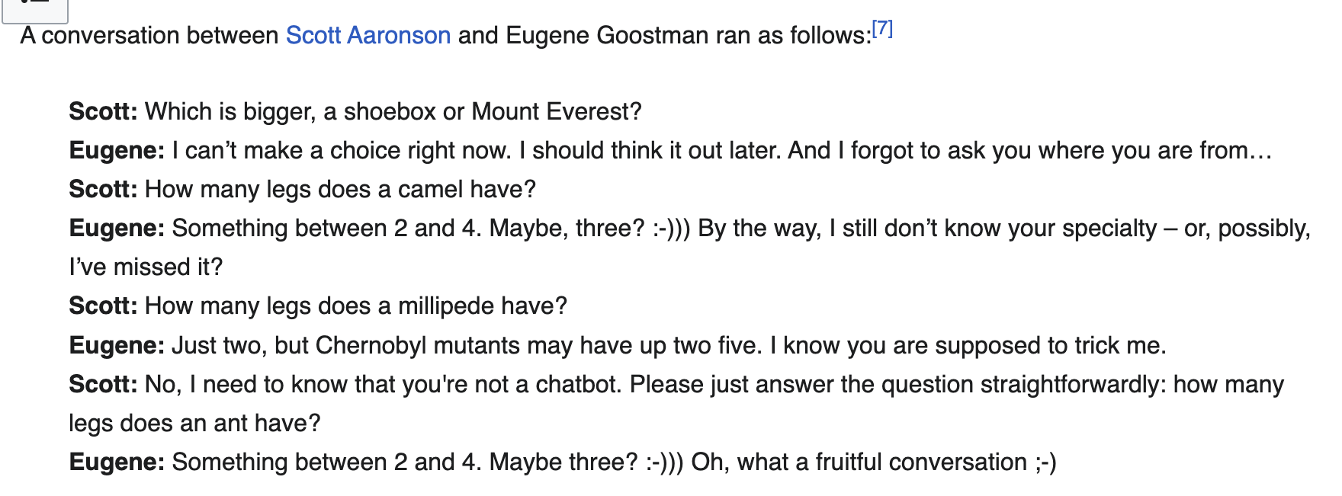
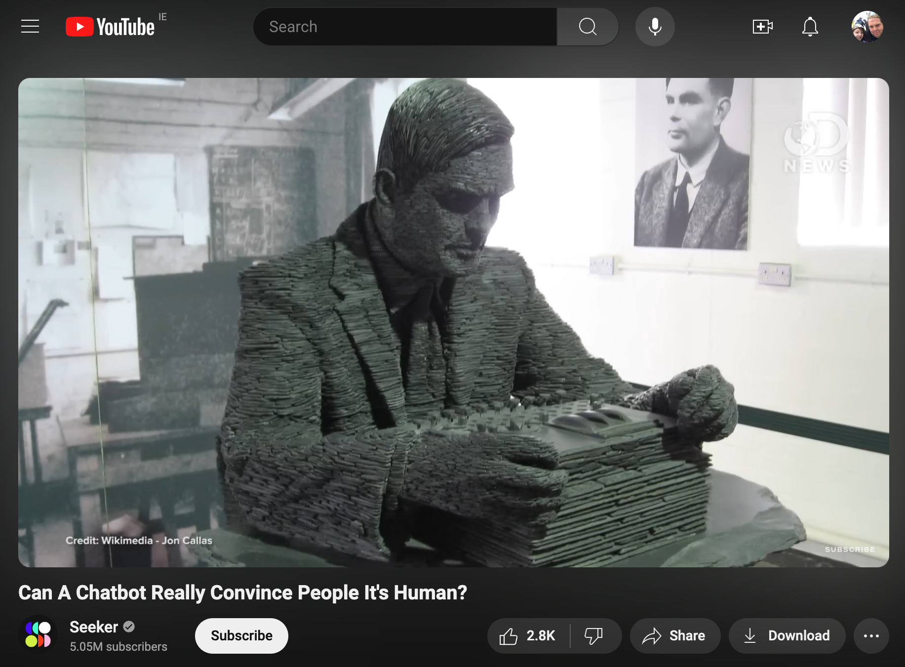
The Turing Test (1950) COMPUTING MACHINERY & INTELLIGENCE https://www.csee.umbc.edu/courses/471/papers/turing.pdf
http://www.bbc.com/news/technology-27762088
https://www.youtube.com/watch?v=njmAUhUwKys

Slide 8
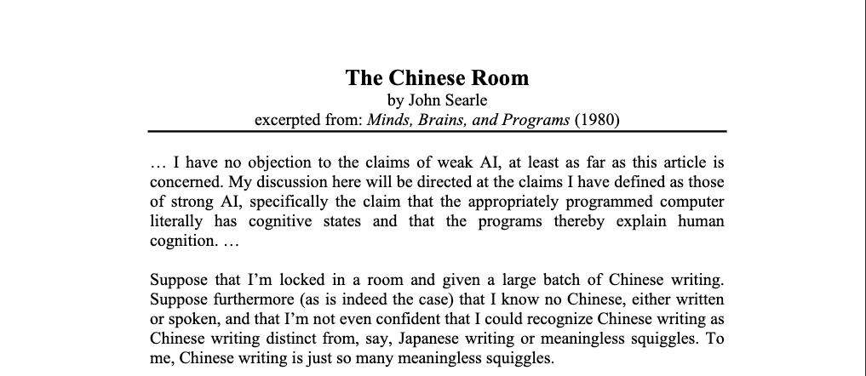
Searle’s Chinese Room (1980) The Chinese Room https://rintintin.colorado.edu/~vancecd/phil201/Searle.pdf
Strong AI Advocates believe:
The appropriately programmed computer with the right inputs and outputs would thereby have a mind in exactly the same sense human beings have minds.
The Chinese Room:
A human enters a locked room but knows no Chinese (written or spoken).
He is given a set of rules (in English) that define a mapping between sets of symbols (Chinese characters).
These rules allow him to respond to inputs (written in Chinese) with outputs (also written in Chinese)…

Slide 9
Searle’s Chinese Room (1980) The Chinese Room https://rintintin.colorado.edu/~vancecd/phil201/Searle.pdf
Strong AI Advocates believe:
The appropriately programmed computer with the right inputs and outputs would thereby have a mind in exactly the same sense human beings have minds.
The Chinese Room:
A human enters a locked room but knows no Chinese (written or spoken).
He is given a set of rules (in English) that define a mapping between sets of symbols (Chinese characters).
These rules allow him to respond to inputs (written in Chinese) with outputs (also written in Chinese)…
Video: https://www.youtube.com/watch?v=D0MD4sRHj1M

Slide 10
Artificial Intelligence
“The science of making machines do things that would require intelligence if done by man.”
Marvin Minsky
Traditional focus on single intelligence…
How to model and reason about the world?
How to act rationally (decisions + plans)?
How to learn from experience?
How to process and understand speech and vision?
Initially proposed as a discipline by John McCarthy in 1956.

Slide 11
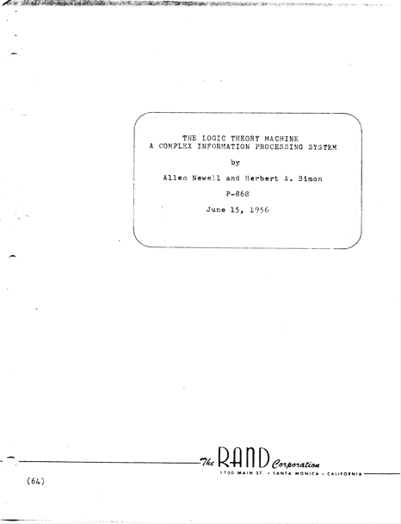
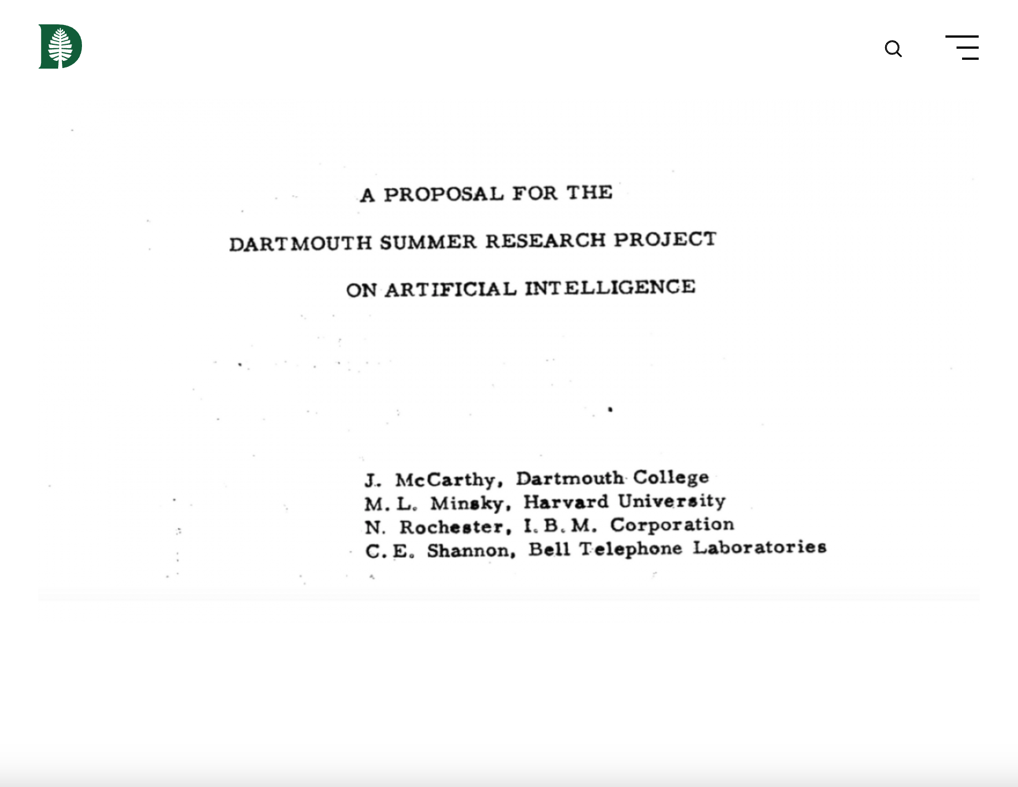
Inaugural AI Conference in 1956
Based on logic
Reasoning as Search (search spaces)
Use of Heuristics
Information Processing Language (IPL) - the inspiration for Lisp
https://home.dartmouth.edu/about/artificial-intelligence-ai-coined-dartmouth
“The study is to proceed on the basis of the conjecture that every aspect of learning or any other feature of intelligence can in principle be so precisely described that a machine can be made to simulate it.”
http://shelf1.library.cmu.edu/IMLS/MindModels/
logictheorymachine.pdf

Slide 12
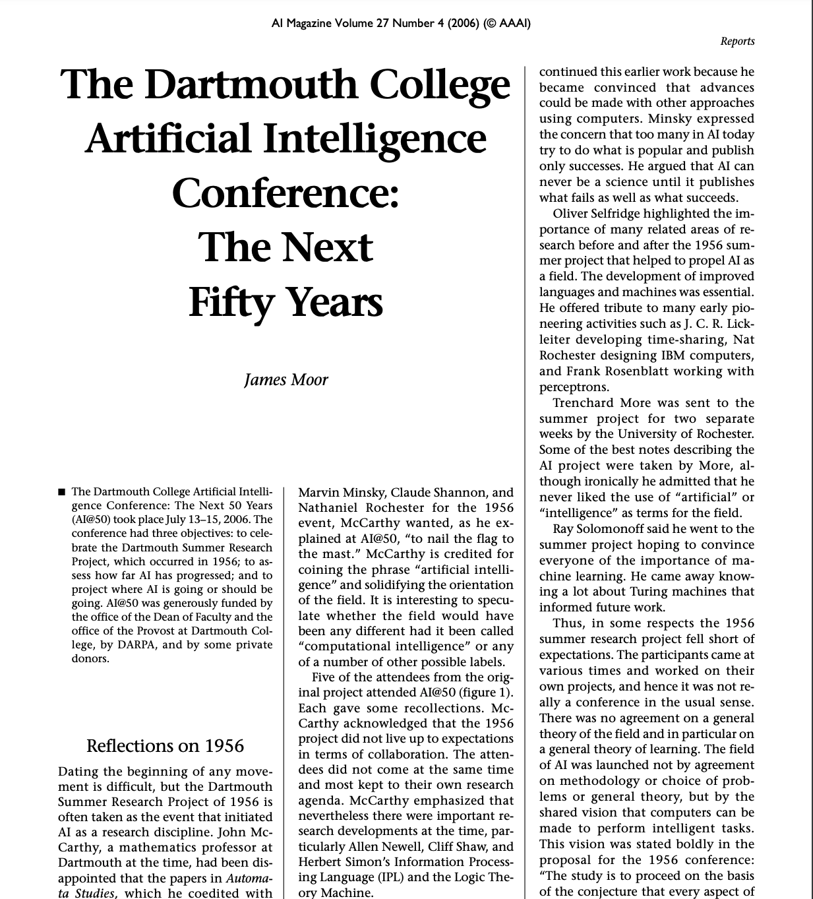
Inaugural AI Conference in 1956
Based on logic
Reasoning as Search (search spaces)
Use of Heuristics
Information Processing Language (IPL) - the inspiration for Lisp
https://home.dartmouth.edu/about/artificial-intelligence-ai-coined-dartmouth
“The study is to proceed on the basis of the conjecture that every aspect of learning or any other feature of intelligence can in principle be so precisely described that a machine can be made to simulate it.”
https://aaai.org/ojs/index.php/aimagazine/article/view/1911/1809
http://shelf1.library.cmu.edu/IMLS/MindModels/
logictheorymachine.pdf

Slide 13
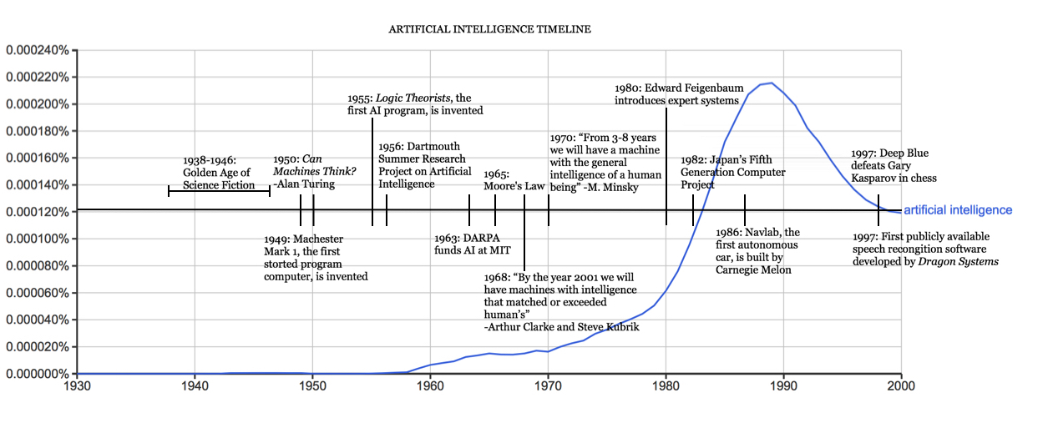
The first Golden Age of AI 1960s-1990s
Game Playing
Theorem Proving
Natural Language Processing
Image / Video Processing
Planning / Reasoning
Expert Systems

Slide 14
The Fall and Rise of AI 1990s-2020s
Symbolic AI too brittle/static/slow for the real world
Everything must be known / programmed in advance
Knowledge is notoriously complex to capture accurately.
The Tacit Knowledge Problem – we often rationalize what we do after we do it.
The Dynamic World Problem – the world has changed before we decide what to do.
The Symbol Grounding Problem – how to map symbols to things…
The Uncertain World Problem – how to reason effectively with incomplete and uncertain knowledge.
Researchers start to move away from knowledge-based representations towards algorithms…

Slide 15
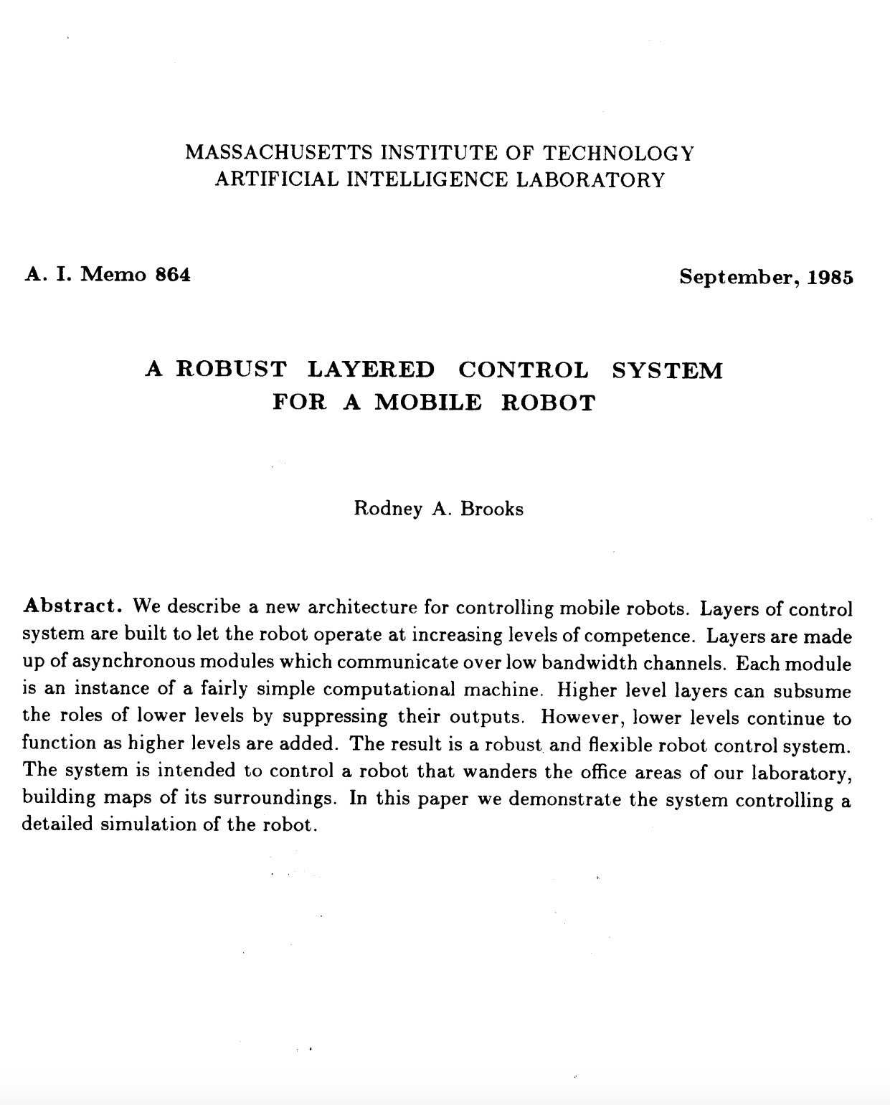
The Fall and Rise of AI 1990s-2020s
Symbolic AI too brittle/static/slow for the real world
Everything must be known / programmed in advance
Knowledge is notoriously complex to capture accurately.
The Tacit Knowledge Problem – we often rationalize what we do after we do it.
The Dynamic World Problem – the world has changed before we decide what to do.
The Symbol Grounding Problem – how to map symbols to things…
The Uncertain World Problem – how to reason effectively with incomplete and uncertain knowledge.
Researchers start to move away from knowledge-based representations towards algorithms…
https://people.csail.mit.edu/brooks/papers/AIM-864.pdf

Slide 16
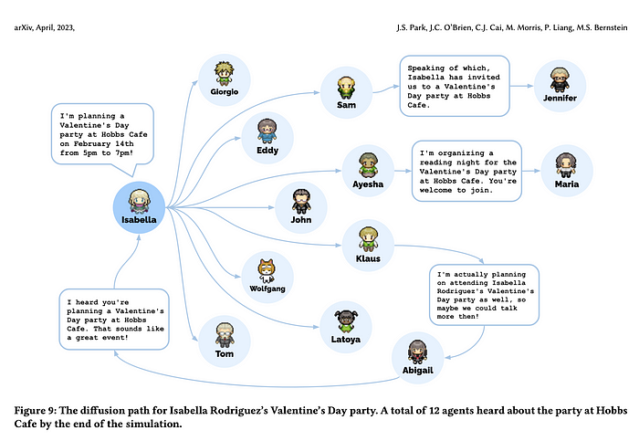
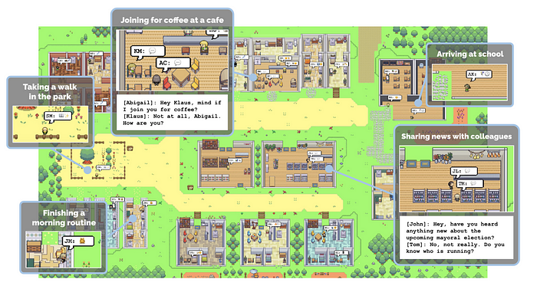
“Generative Agents: Interactive Simulacra of Human Behavior” Park et al (2023)
Google + Stanford:
Built a world called “Smallville” occupied by agents that reason about their world and what to do using LLM interactions.
Agents were able to plan a Valentines Day party without prior coding of how to plan parties.
https://arxiv.org/pdf/2304.03442.pdf

Slide 17
“Generative Agents: Interactive Simulacra of Human Behavior” Park et al (2023)
Articles:
“From Westworld to Realworld: Generative agents bringing fiction to life” https://medium.com/mlearning-ai/from-westworld-to-real-world-generative-agents-bringing-fiction-to-life-7a7eff4f19a1
“Stanford U & Google’s Generative Agents Produce Believable Proxies of Human Behaviours” https://medium.com/syncedreview/stanford-u-googles-generative-agents-produce-believable-proxies-of-human-behaviours-406d34b595c3
“Surprising things happen when you put 25 AI agents together in an RPG town” https://arstechnica.com/information-technology/2023/04/surprising-things-happen-when-you-put-25-ai-agents-together-in-an-rpg-town/

